Slide 1
Virtual
Campaign
K-pop Corner
Internet K-pop Shop
Here is where your marketing campaign begins

Slide 2

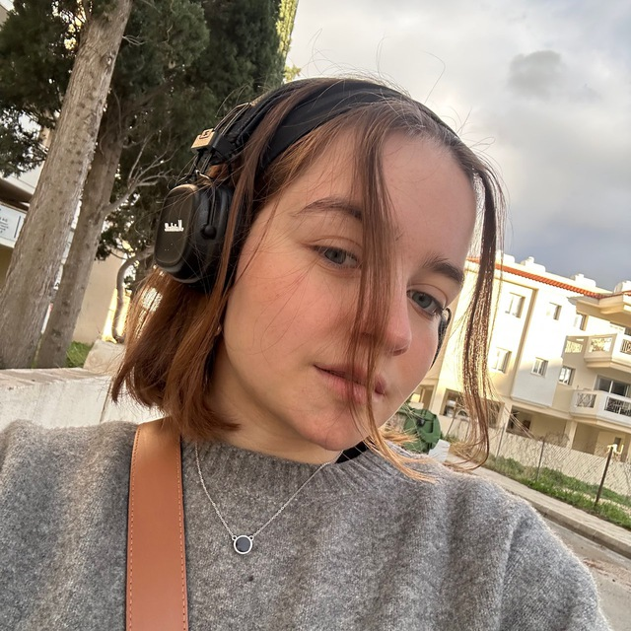
OUR TEAM
Maria Vichuganova
Olga Bugaeva

Slide 3
ABOUT OUR PROJECT
PAGES
01
04
ACCESS MANAGEMENT
SHOPPING CART
02
05
SEARCH ENGINE
USER TYPES
03
06

Slide 4
01
ABOUT OUR PROJECT

Slide 5

K-POP CORNER
"K-pop Corner" is your ultimate online destination for all things K-pop. Specializing in a diverse range of K-pop merchandise, our store offers an extensive collection of albums, official lightsticks, and exclusive merch from your favorite idols and groups.

Slide 6
ACCESS MANAGEMENT
02

Slide 7
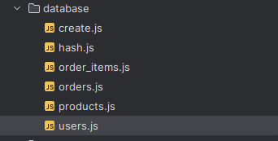
DATABASE
We’ve created multiple database files to support such things as: list of existing users (their names, emails, passwords), list of products (that you could add manually if you have admin access) and so on

Slide 8
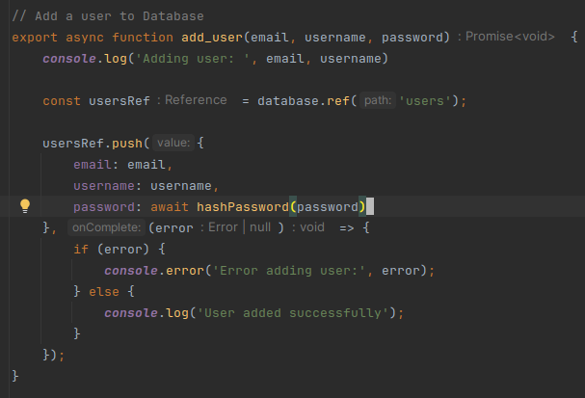
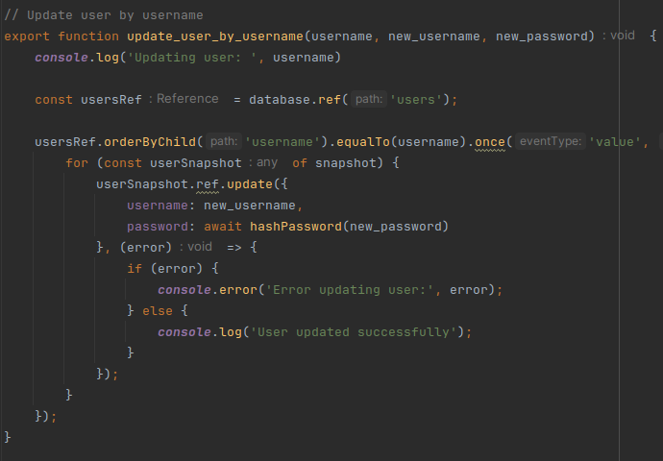
EXAMPLES OF FUNCTIONS

Slide 9
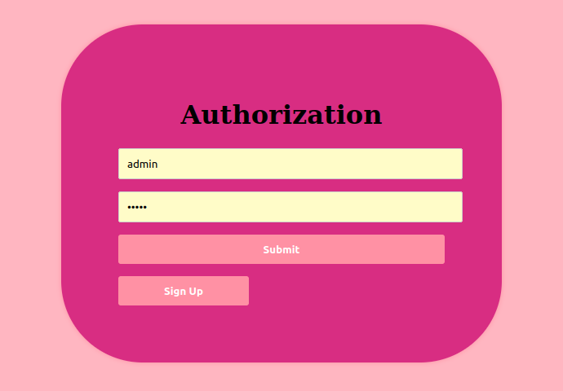
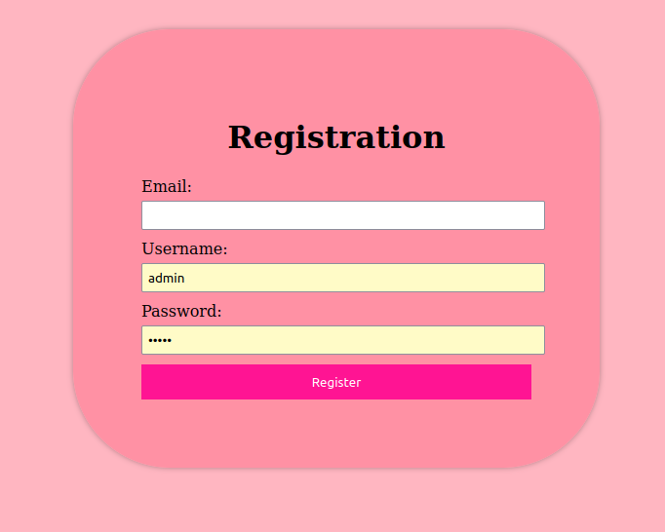
ACCESS PAGE

Slide 10
SEARCH
ENGINE
03

Slide 11
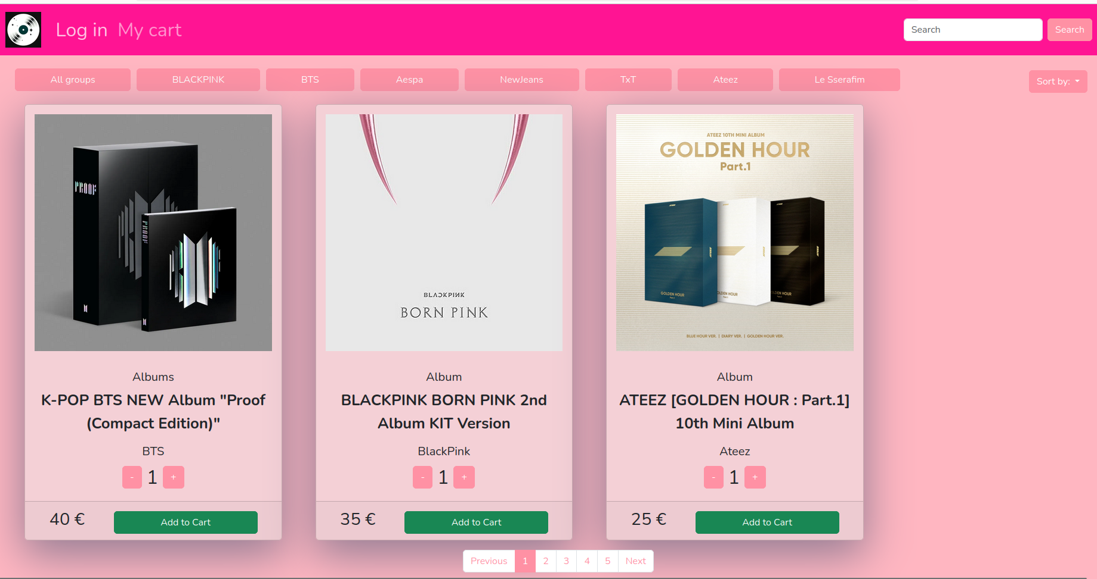
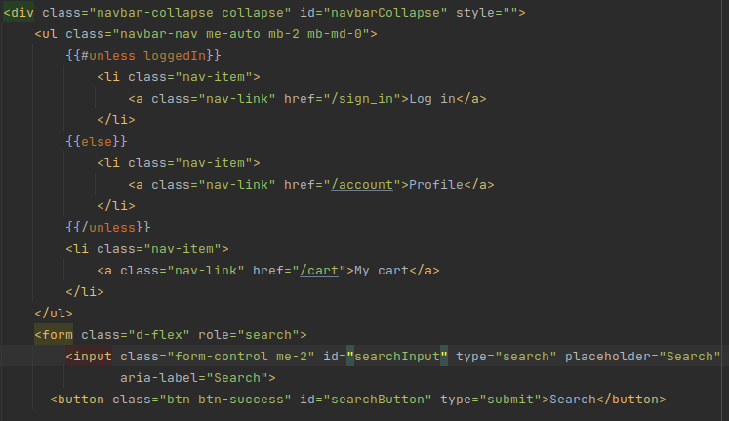
Search engine

Slide 12
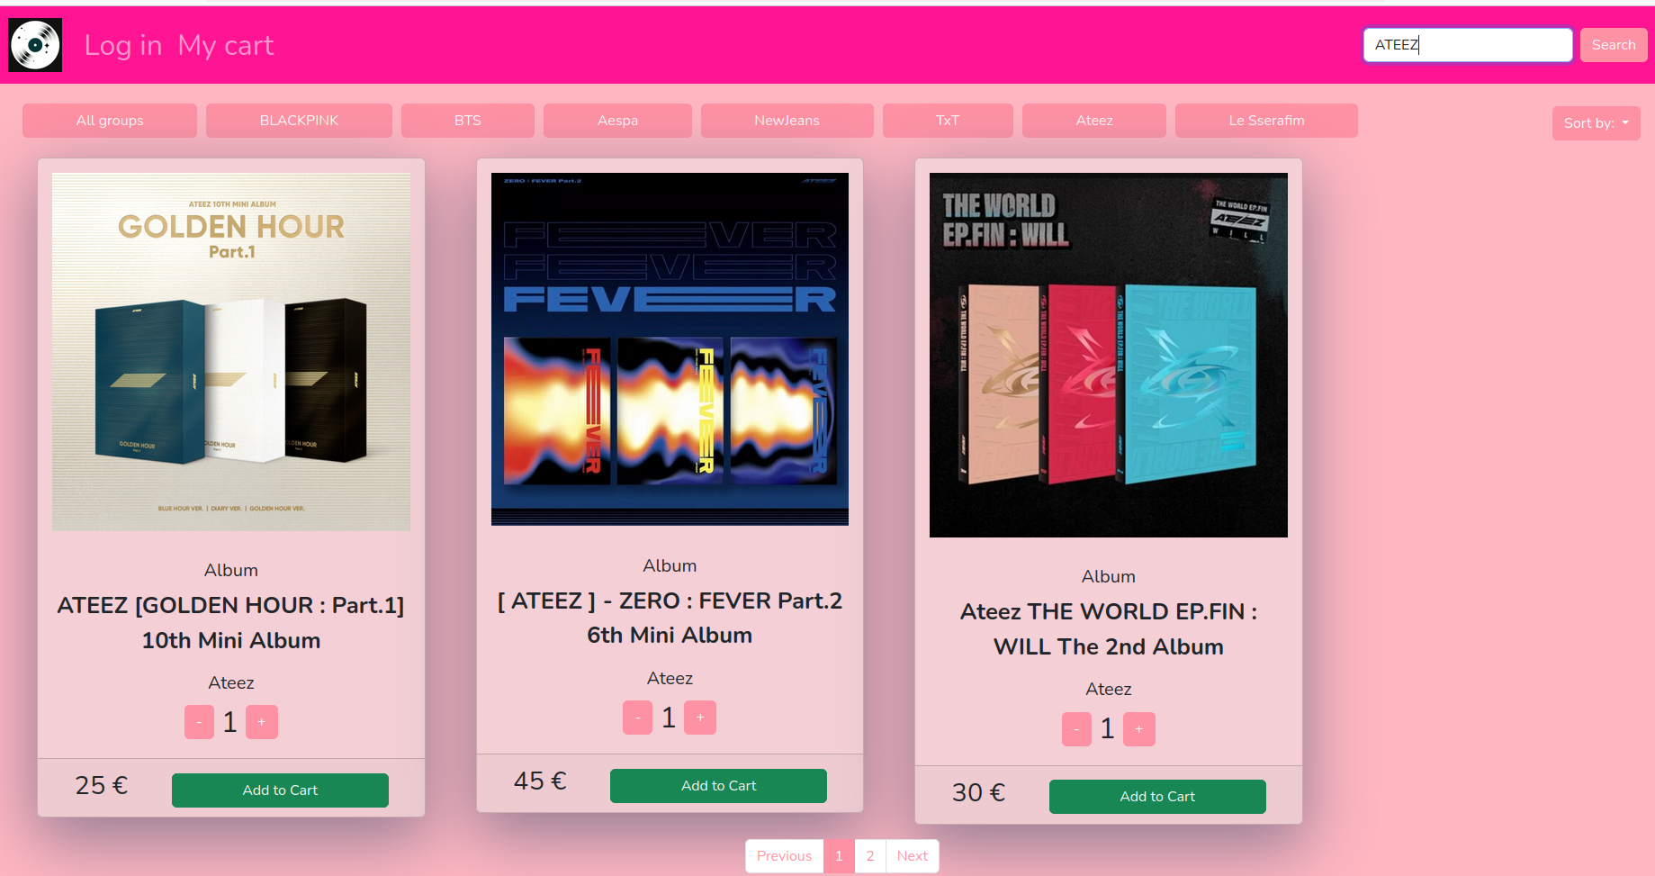
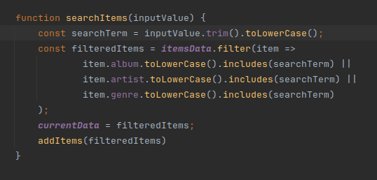
Search engine

Slide 13
04
Pages

Slide 14
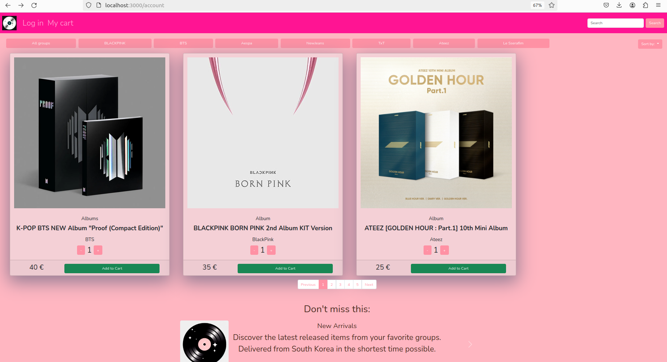
Home page

Slide 15
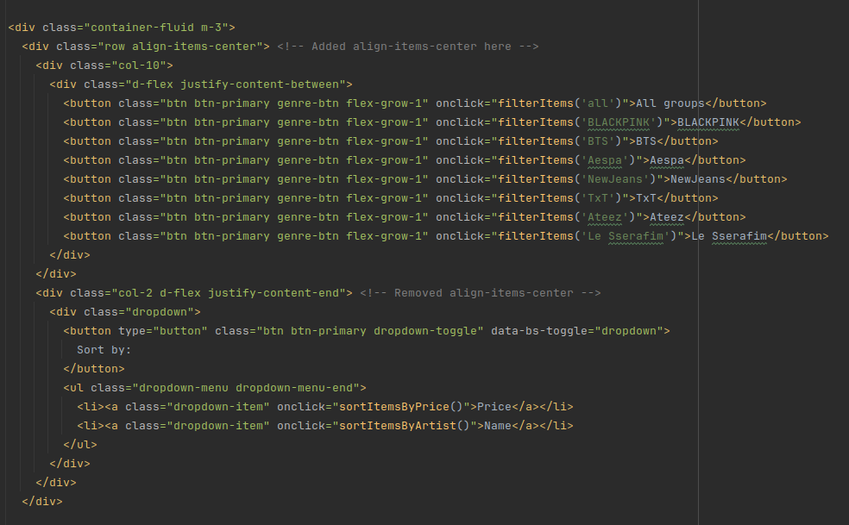
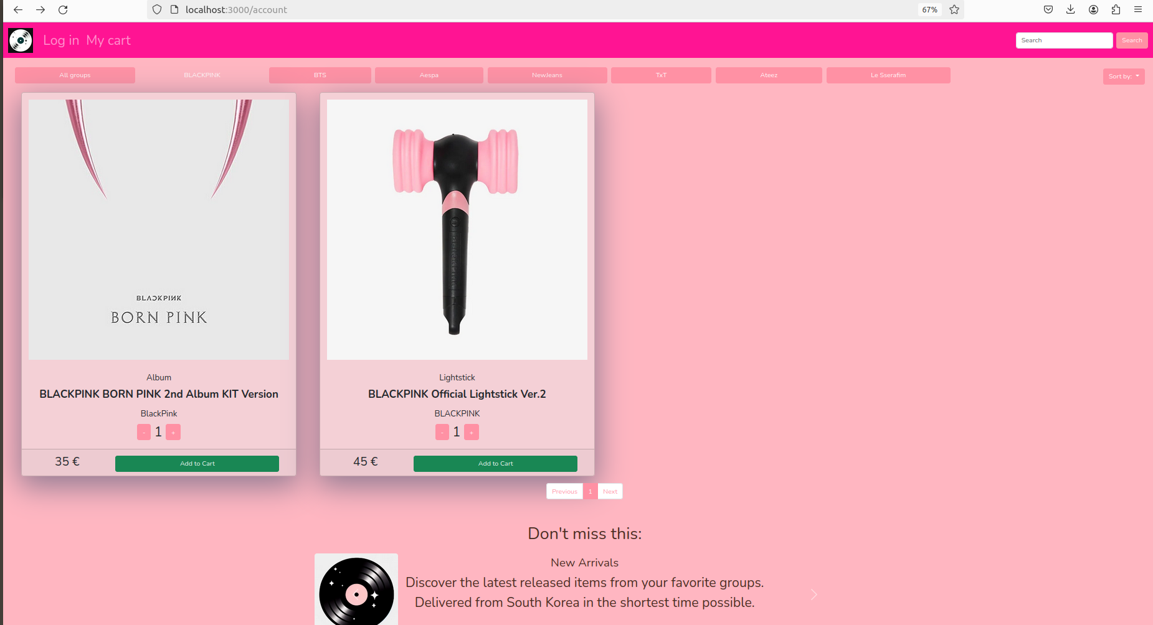
Category page
A page from where users can see the items of specific artists

Slide 16
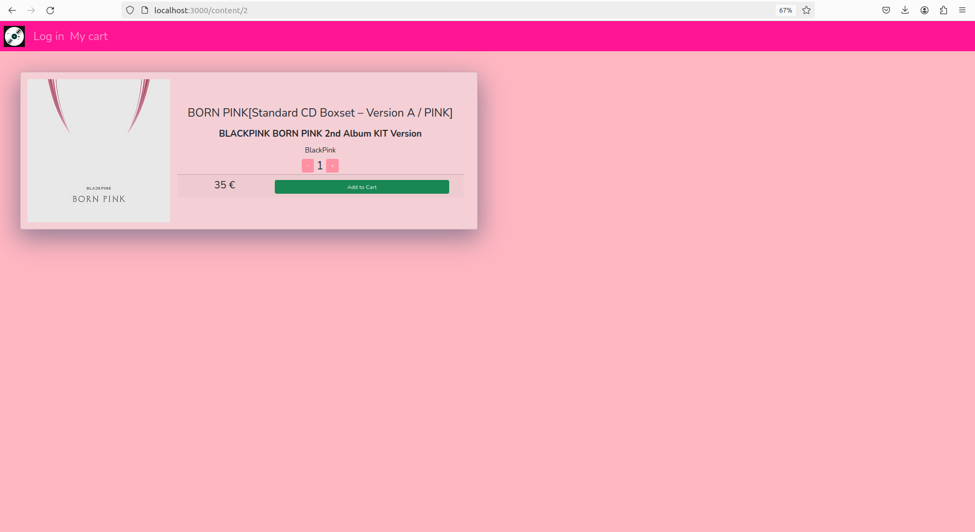
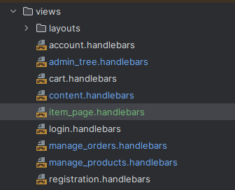
Product detail page
A page from where users can drill down to some specific product. It’s accessed by clicking the image of an item.

Slide 17
05
Shopping Cart

Slide 18
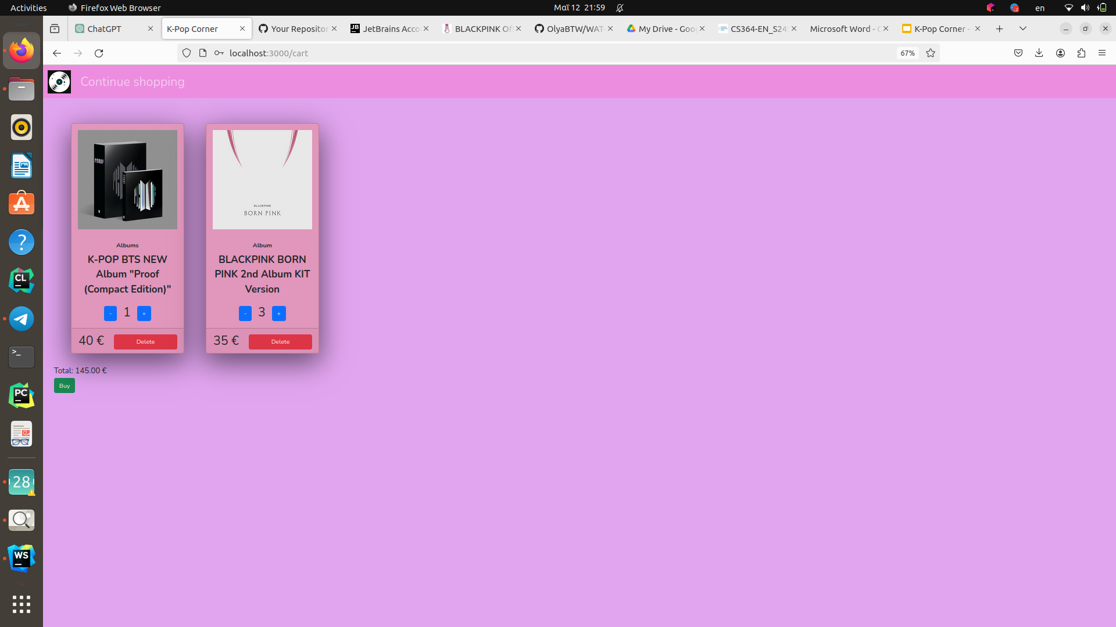
Selection mechanisms

Slide 19
06
User Types

Slide 20
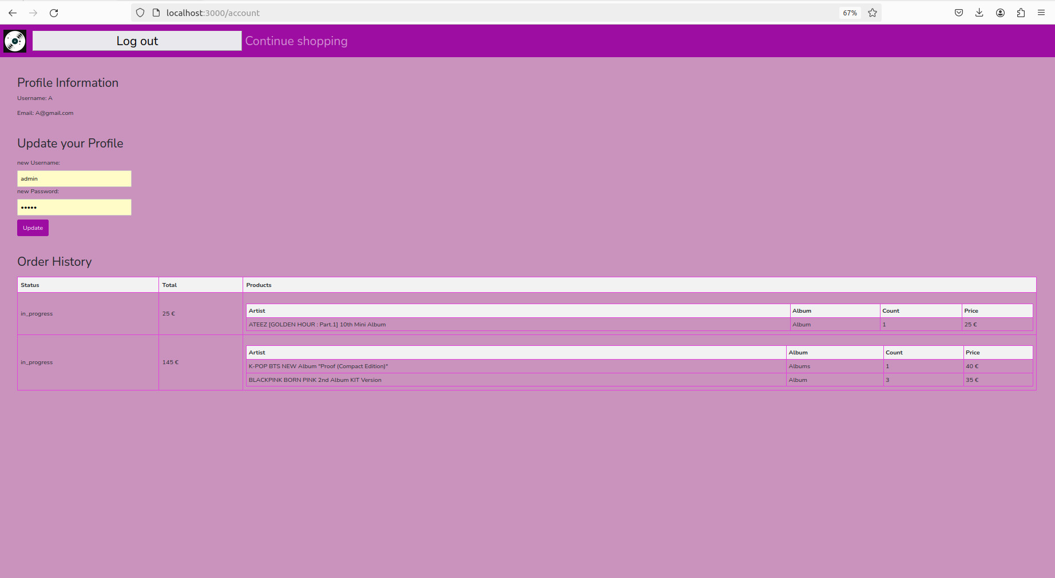
User Panel

Slide 21
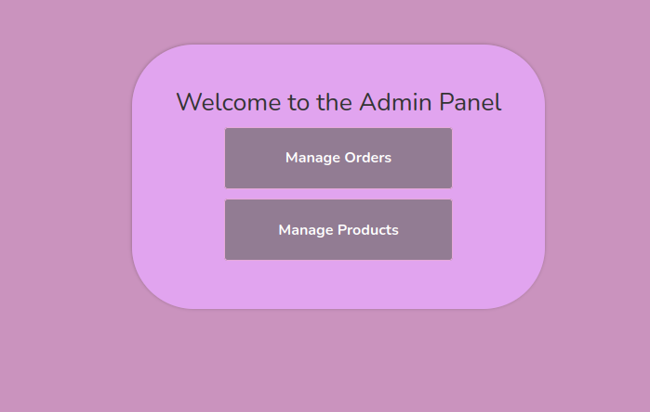
Admin Panel

Slide 22
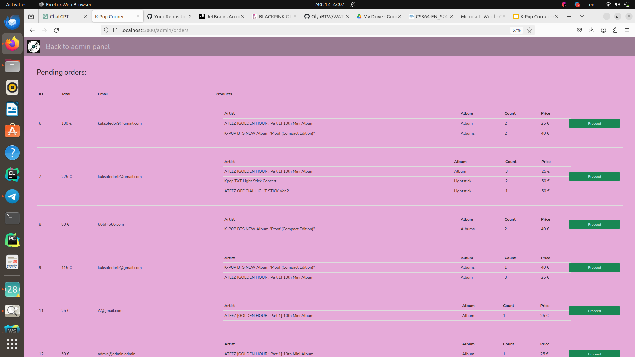
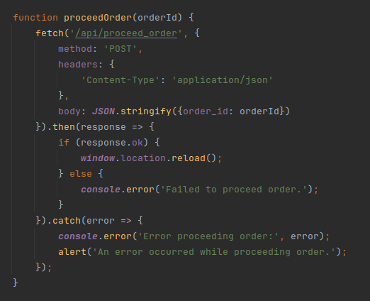
ORDERS MANAGEMENT

Slide 23
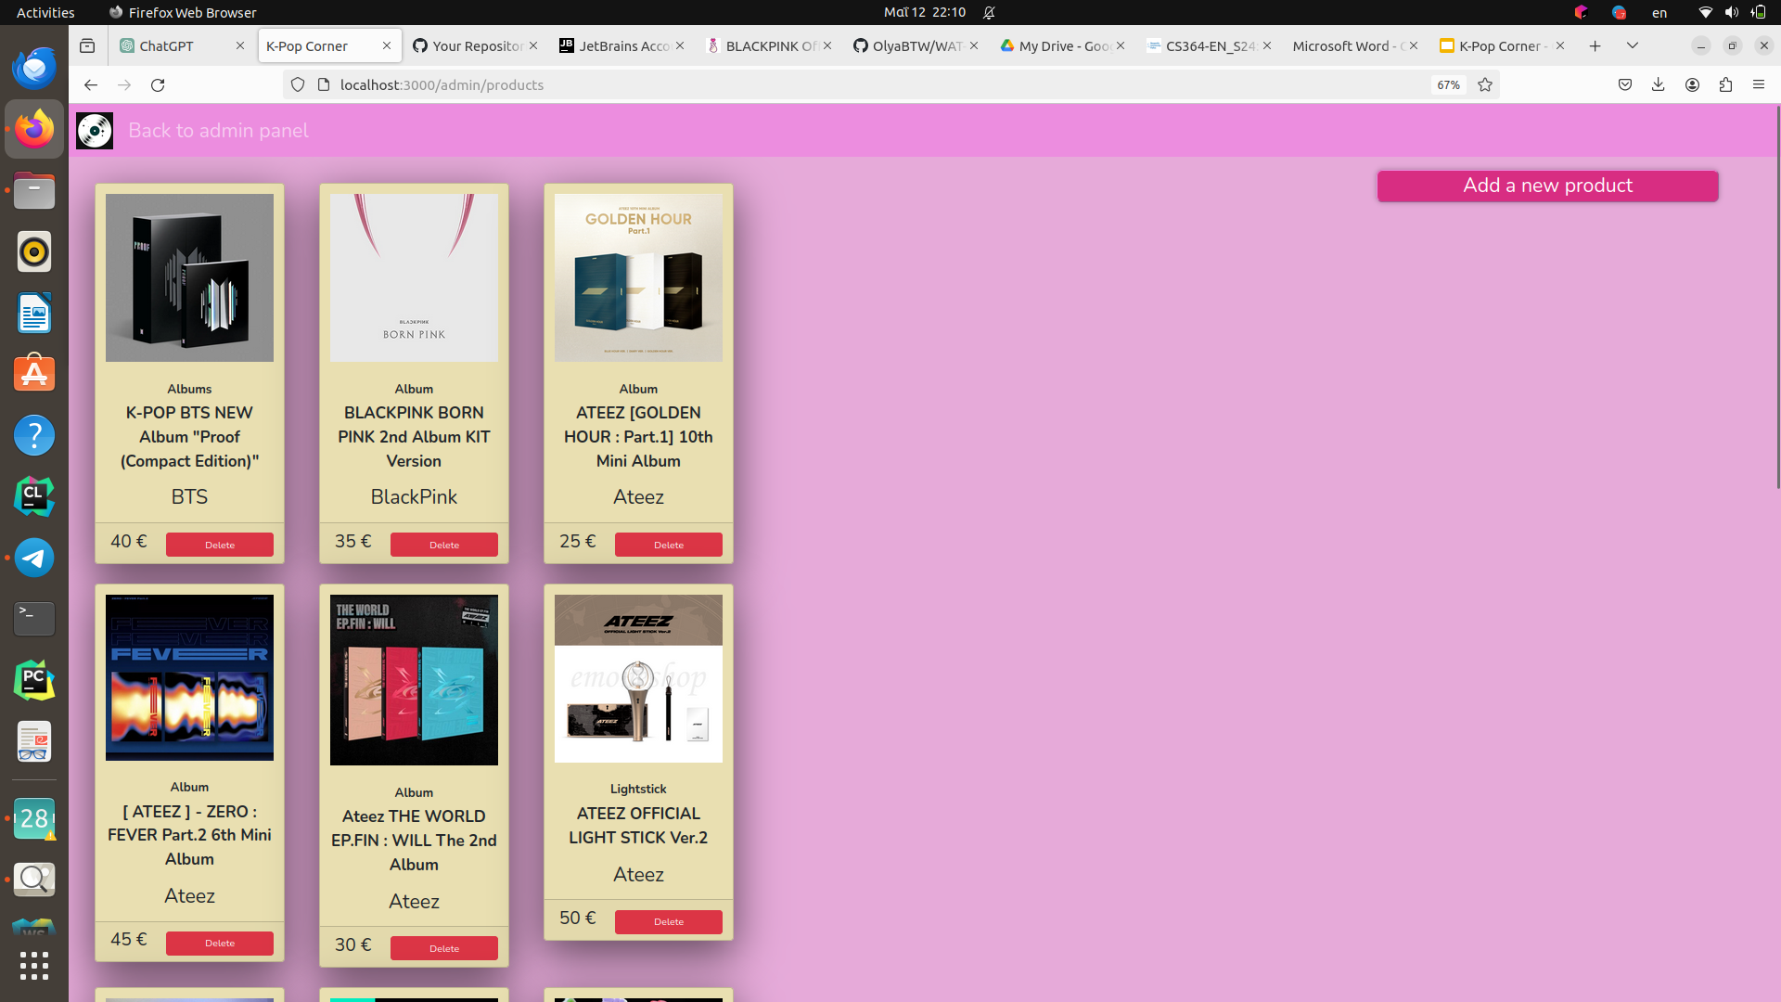
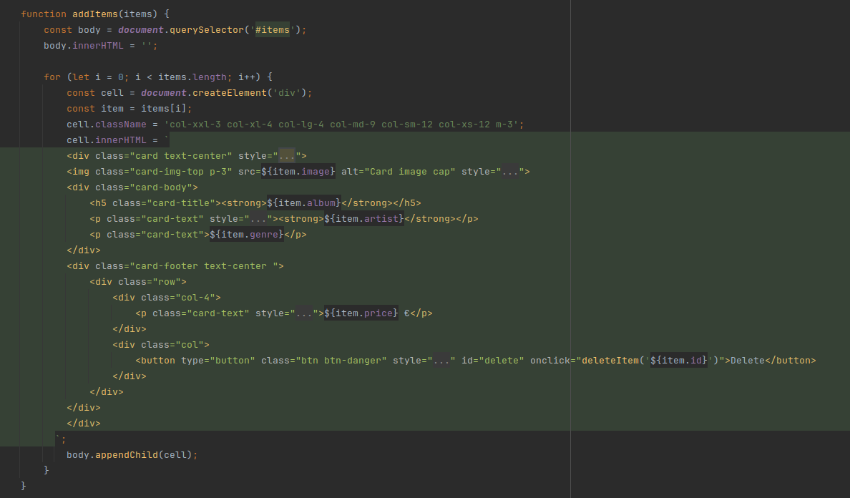
PRODUCTS MANAGEMENT

